Slide 1
Нейросетевые решения для CV Vision Large Models (VLM) Диффузионные модели

Slide 2
Нейросетевые решения для CV

Slide 3
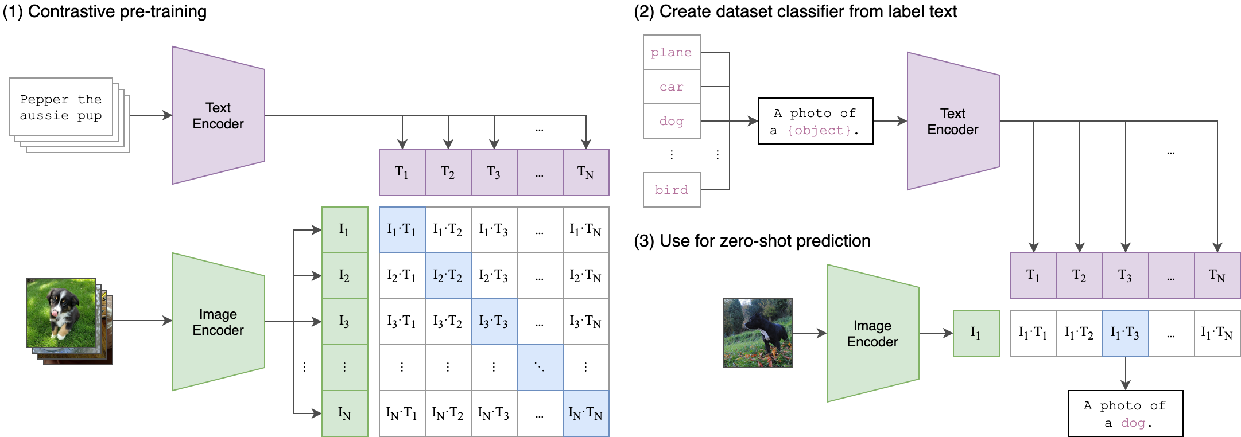
Zero-shot классификация
CLIP

Slide 4
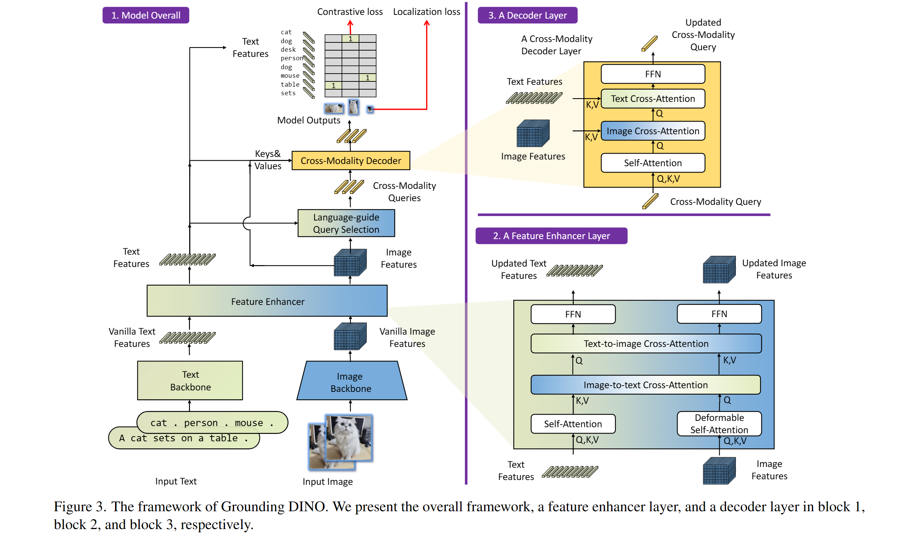
Zero-shot детекция
Grounding DINO

Slide 5
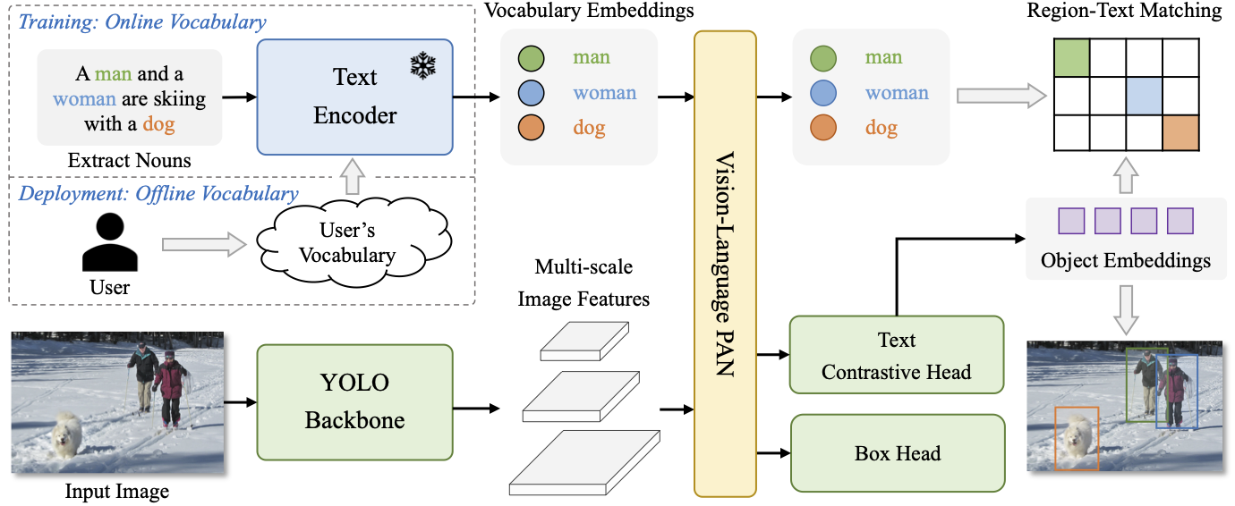
Zero-shot детекция
YOLO-World

Slide 6
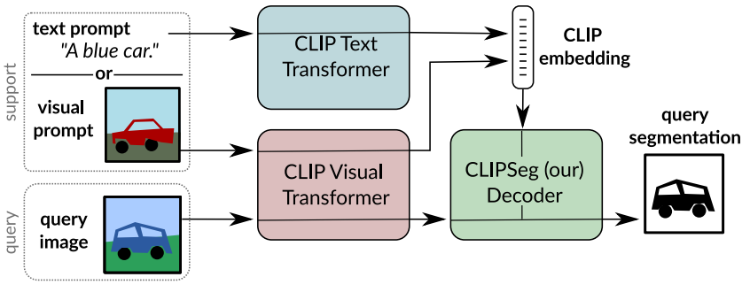
Zero-shot сегментация
CLIPSeg

Slide 7
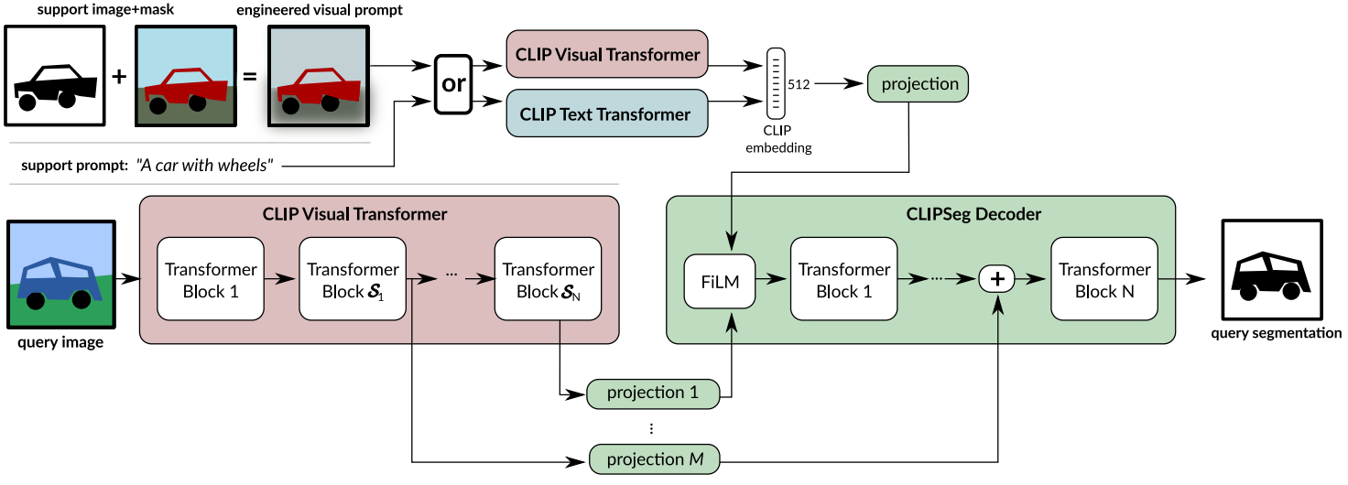
Zero-shot сегментация
CLIPSeg

Slide 8
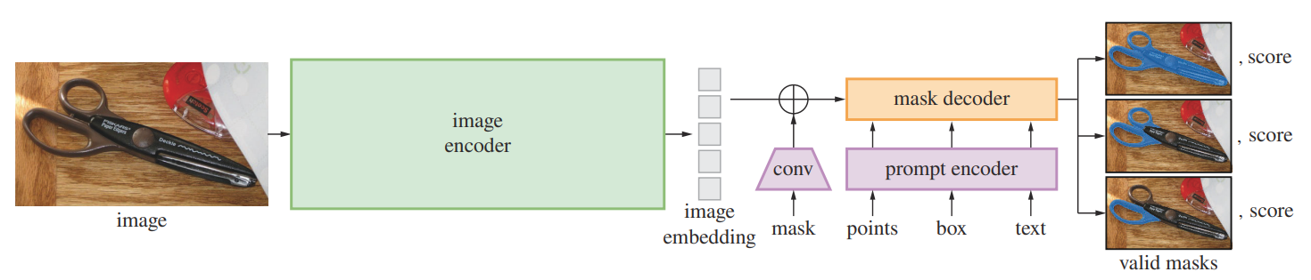
Интерактивная сегментация
Segment Anything Model (SAM)

Slide 9
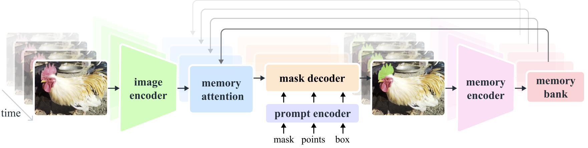
Интерактивная сегментация
Segment Anything Model 2 (SAM2)

Slide 10
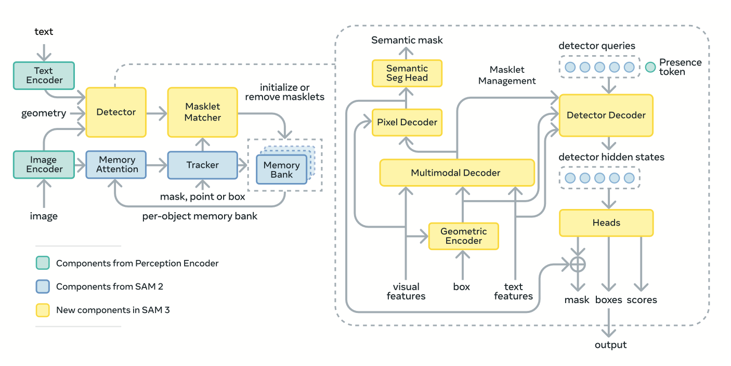
Zero-shot instance сегментация
Segment Anything Model 3 (SAM3)

Slide 11
Zero-shot instance сегментация
Segment Anything Model 3 (SAM3)
Feature | SAM 1 | SAM 2 | SAM 3
Zero-Shot Segmentation Quality | ★★☆☆☆ | ★★★★☆ | ★★★★★
Small Object Performance | ★☆☆☆☆ | ★★☆☆☆ | ★★★★☆
Boundary Accuracy | ★★☆☆☆ | ★★★☆☆ | ★★★★★
Prompt Types Supported | Points, Boxes | Points, Boxes, Masks | Points, Boxes, Masks, Text, Examples
Video Segmentation | – | Limited | Full video support
3D / Volumetric Segmentation | – | Experimental | Supported
Inference Speed | Medium | Medium | Faster + more efficient
Memory Efficiency | High usage | Moderate usage | Optimized / lower
Fine-Tuning Support | None | Limited | Stable + recommended
Cross-Domain Robustness | Weak | Moderate | Strong
Model Size Options | Multiple sizes | Multiple sizes | Singular, large model
License Clarity | Custom | Custom | Custom

Slide 12
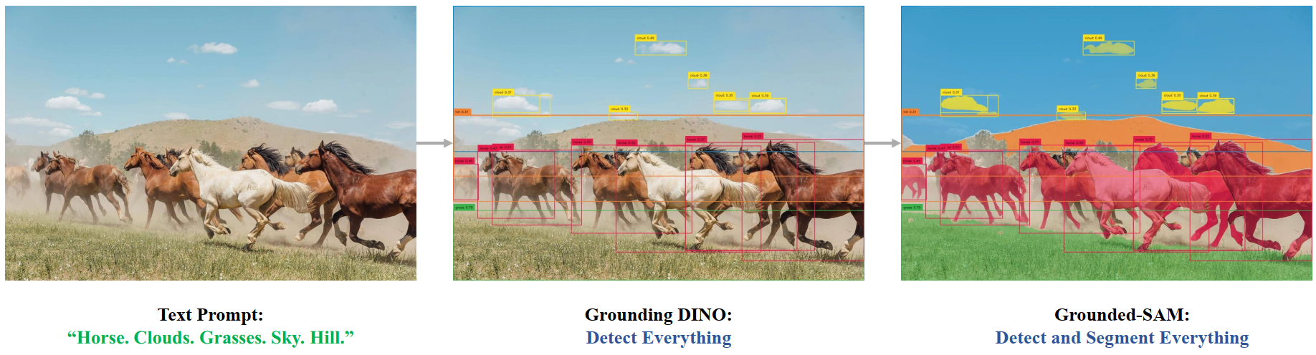
Zero-shot instance сегментация
Grounded Segment Anything (GroundingDINO + SAM)
https://github.com/IDEA-Research/Grounded-Segment-Anything

Slide 13
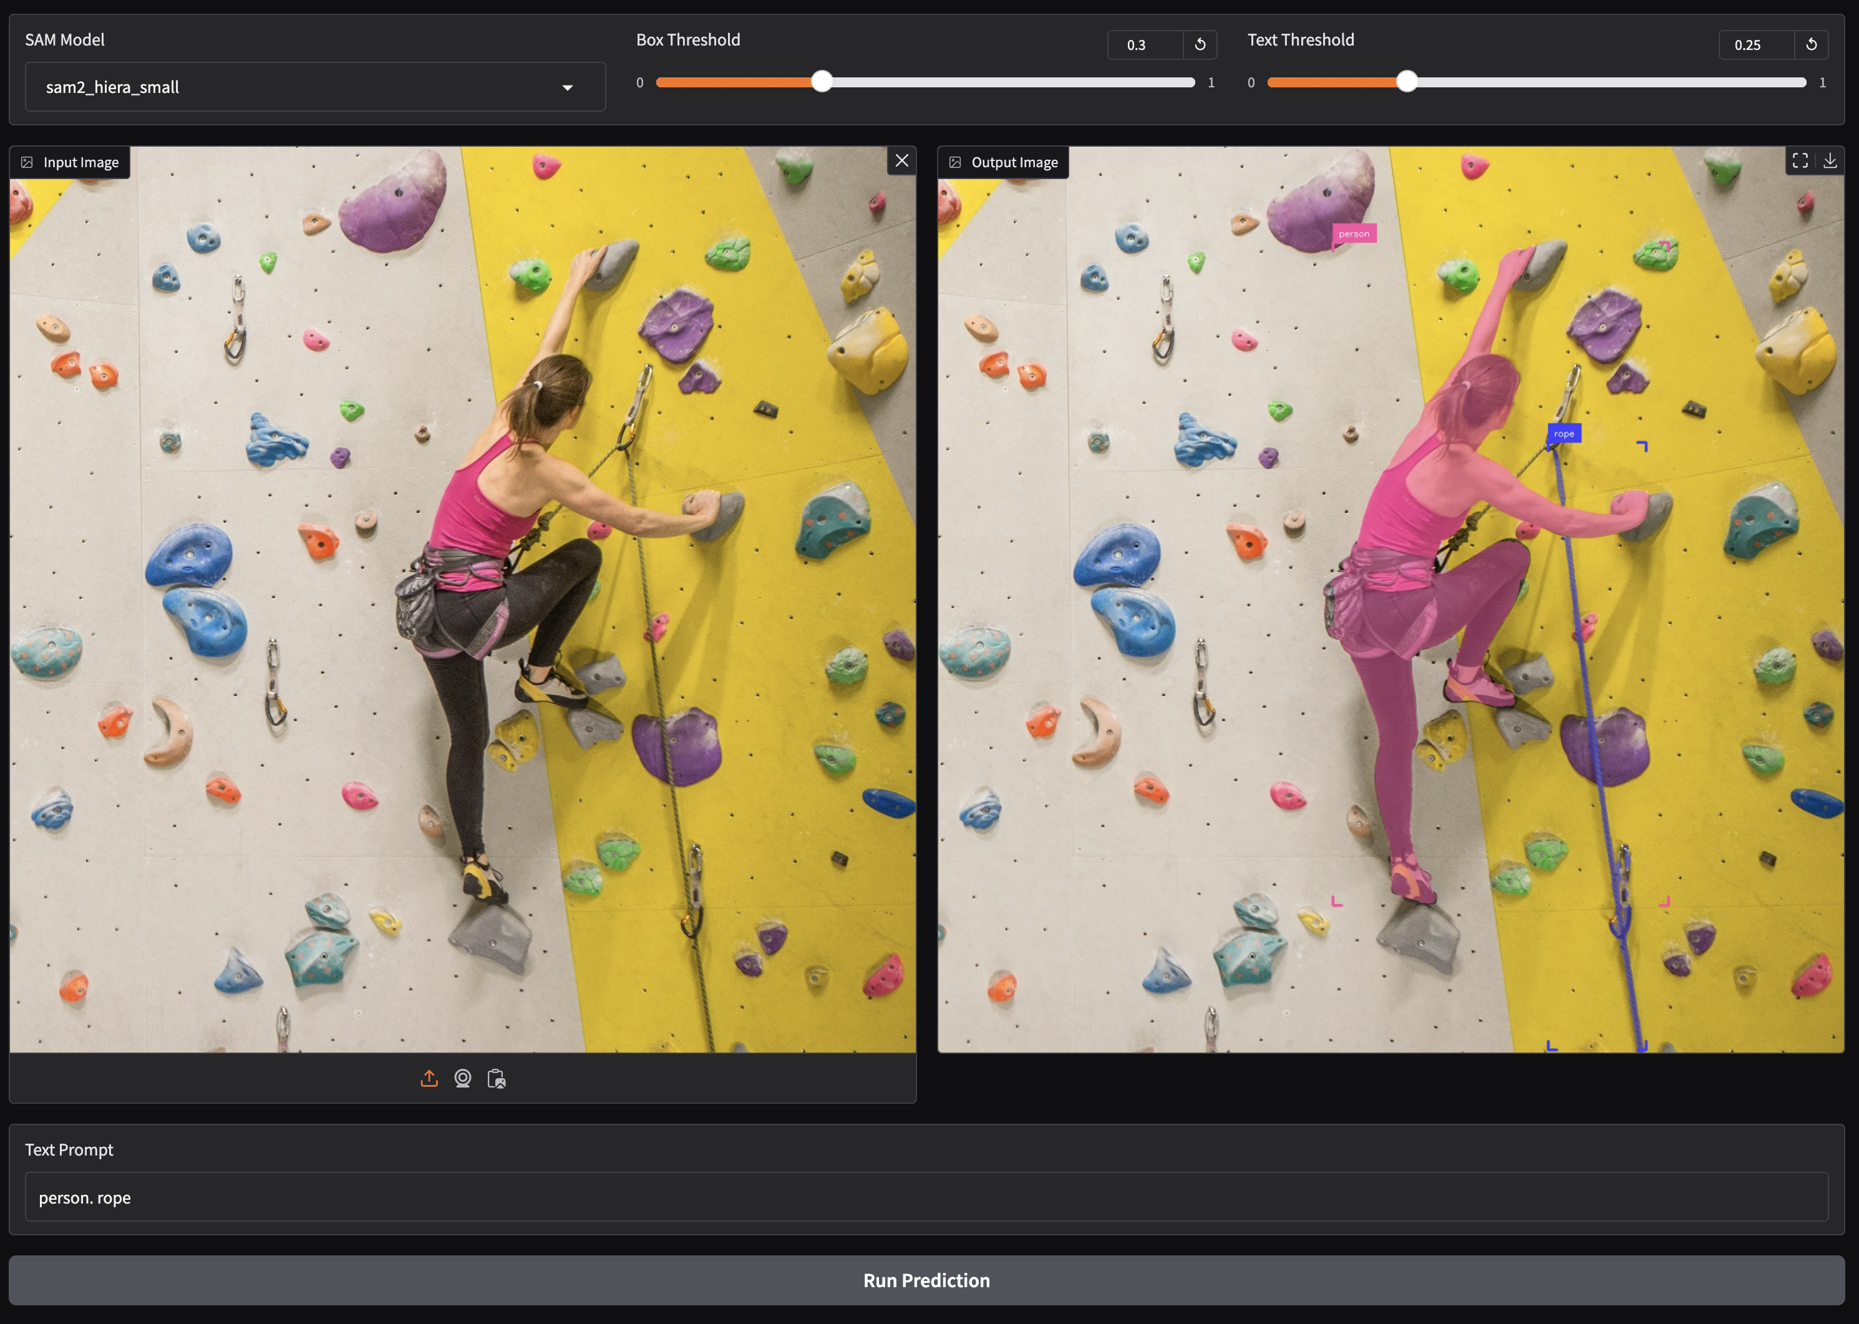
Zero-shot instance сегментация
LangSAM (GroundingDINO + SAM)
https://github.com/luca-medeiros/lang-segment-anything

Slide 14
Ссылки на colab
YOLO-World
CLIPSeg
SAM2
SAM3

Slide 15
Vision Large Models (VLM)

Slide 16
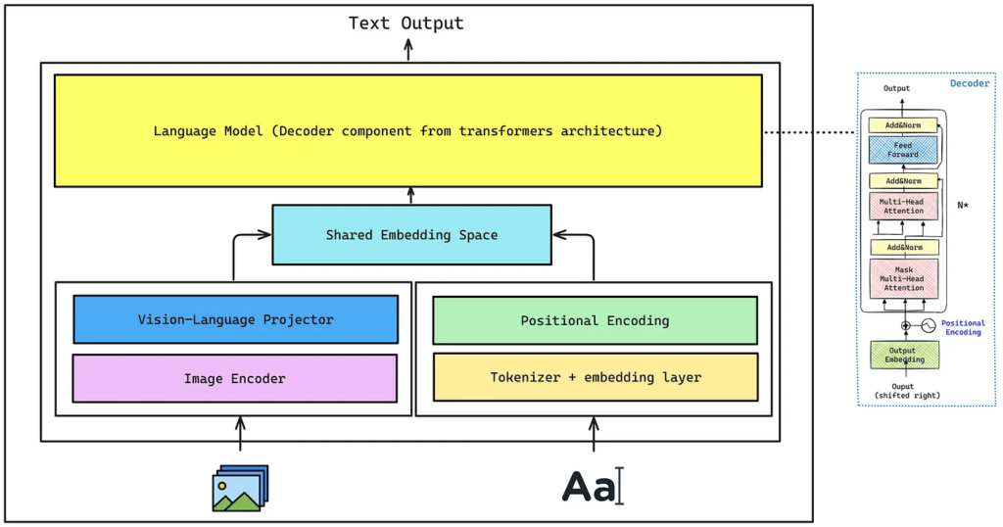
VLM
Ключевые компоненты

Slide 17
VLM
Эволюция VLM
Pioneering Models (e.g., CLIP): OpenAI’s CLIP (Contrastive Language-Image Pre-training), released in 2021, was a major breakthrough. CLIP was trained on a massive dataset of image-text pairs from the internet. It learned to determine how well a given text description matched an image. While it couldn’t generate descriptions itself, it created a powerful shared embedding space that became a foundational block for future models.
Generative Models (e.g., Flamingo, LLaVA): The next step was to move from matching to generating. Models like Google’s Flamingo and, more recently, LLaVA (Large Language and Vision Assistant) were built upon these ideas. LLaVA, for instance, connects the vision backbone of CLIP with a powerful LLM (like Vicuna). By using a simple fusion mechanism and fine-tuning the model on instruction-following datasets, LLaVA demonstrated the ability to have complex, conversational dialogues about images, marking a significant step towards the VLM assistants we see today.

Slide 18
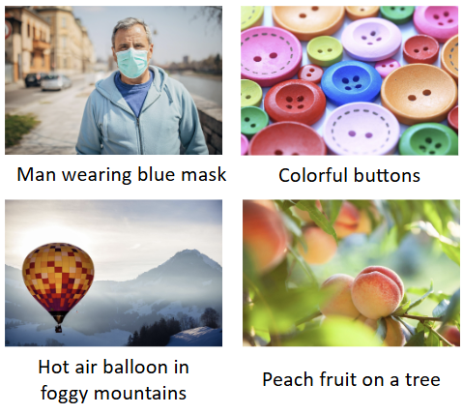
VLM
Применения VLM
Image Captioning: Automatically generating accurate and descriptive captions for images, which is invaluable for accessibility (e.g., screen readers for the visually impaired) and content organization.

Slide 19
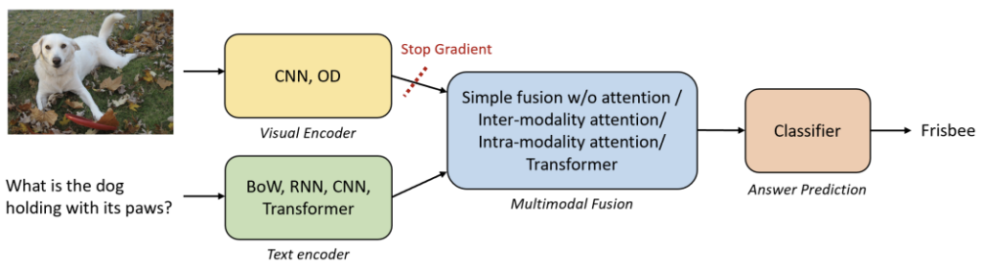
VLM
Применения VLM
Visual Question Answering (VQA): Asking specific questions about an image and getting detailed answers. For example, “How many people are sitting at the table in this cafe?” or “What color is the car on the right?”

Slide 20
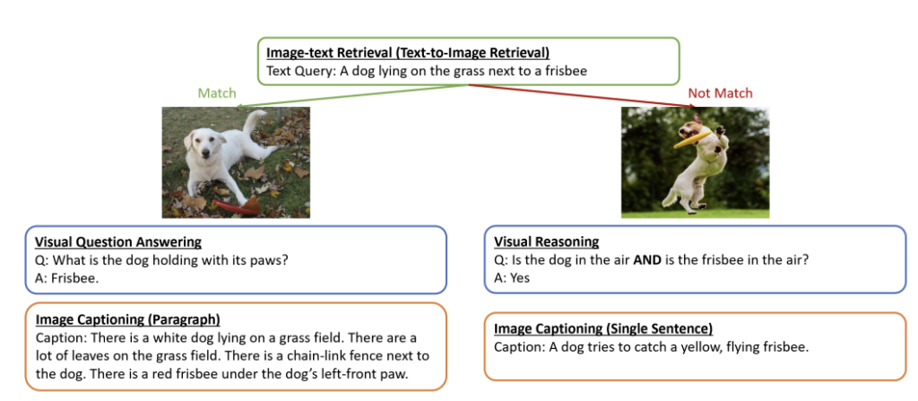
VLM
Применения VLM
Image-Text Retrieval: Revolutionizing search engines. Instead of just searching with text, you can use an image and text to find what you’re looking for. For instance, uploading a picture of a chair and asking, “Where can I buy a similar dining chair but in blue?”

Slide 21

VLM
Дообучение VLM
Vision Fine-Tuning

Slide 22
Parameter Efficient fine-tuning (PEFT)
LoRA
QLoRA

Slide 23
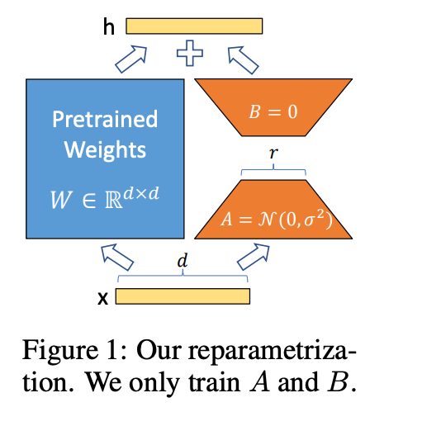


LoRA
Линейный слой
$$h=Wx$$
Линейный слой после добавления обучаемых матриц A и B
$$h=Wx+BAx$$
При этом матрица W имеет размерность [d, d], а матрицы A и B — размерности [d, r] и [r, d] соответственно, где r << d
(обычные значения d — это 8, 16, 32).
Таким образом, мы обучаем только 2 * r * d параметров вместо d * d

Slide 24
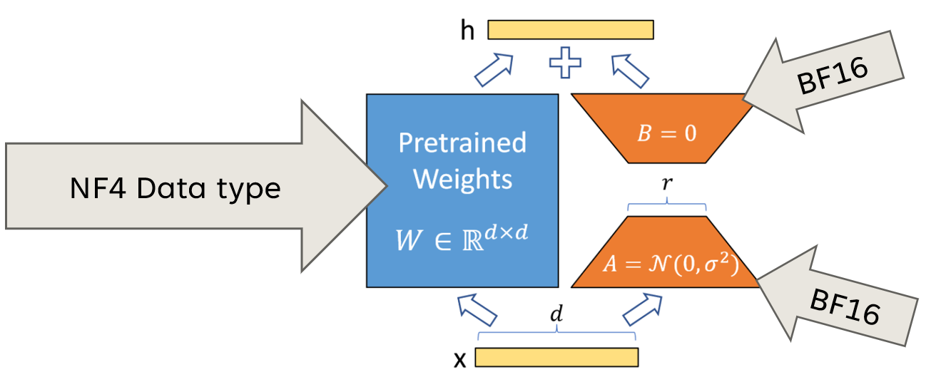
QLoRA

Slide 25
Диффузионные модели

Slide 26
Диффузионные модели
https://colab.research.google.com/drive/10YxVSMICltPUkGD6R-Wj4EqTj0IbXRQn?usp=sharing
https://colab.research.google.com/drive/1xK5CALh7frhbKLg5ICBAiHCSA-AvVfw4?usp=sharing

Slide 27
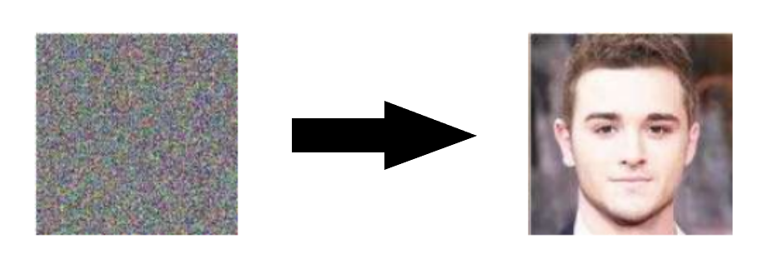
Диффузионные модели

Slide 28
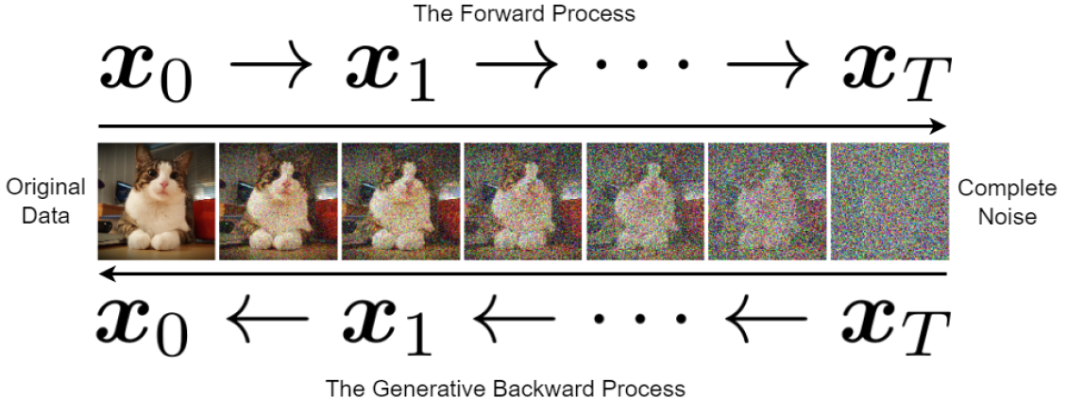
Диффузионные модели

Slide 29
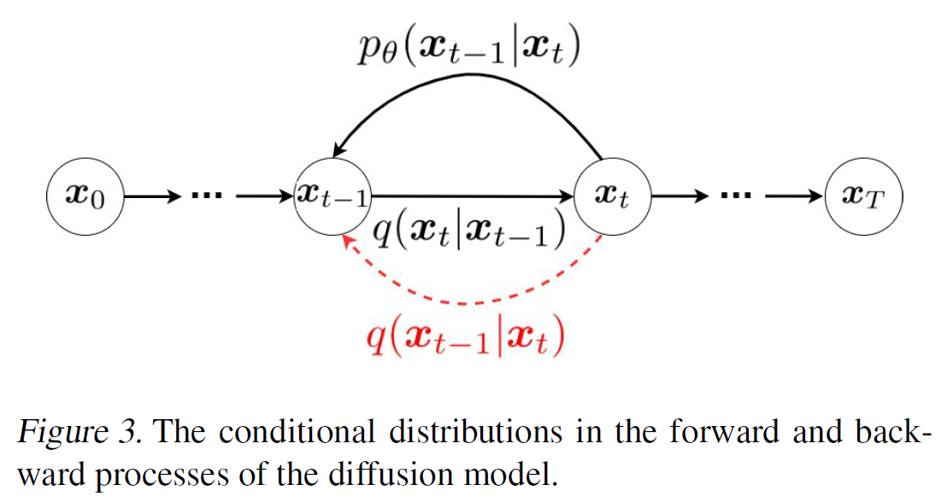
Диффузионные модели

Slide 30
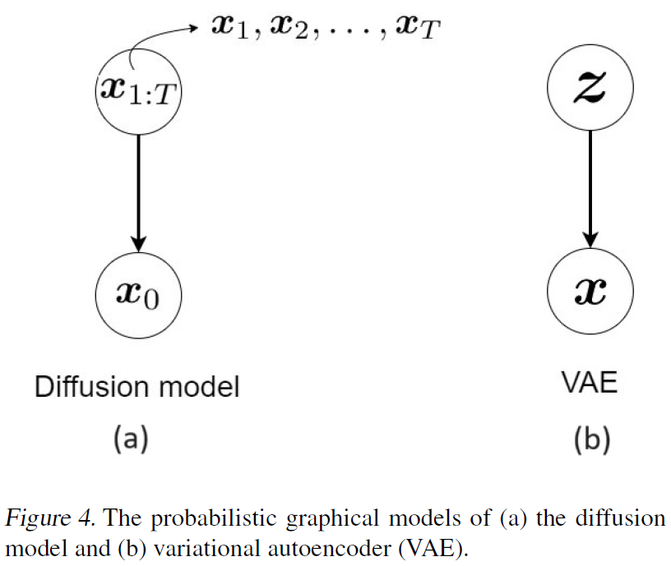
Диффузионные модели

Slide 31
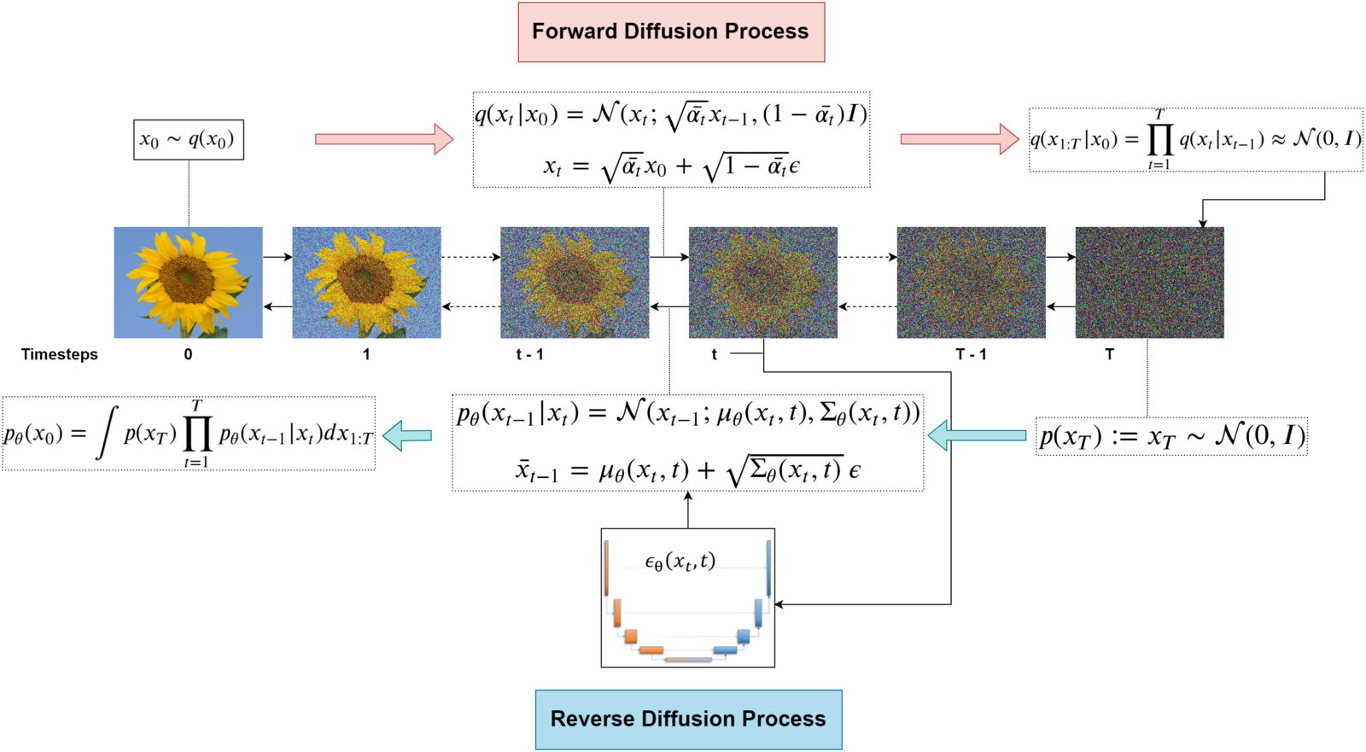
Диффузионные модели
https://learnopencv.com/denoising-diffusion-probabilistic-models/

Slide 32
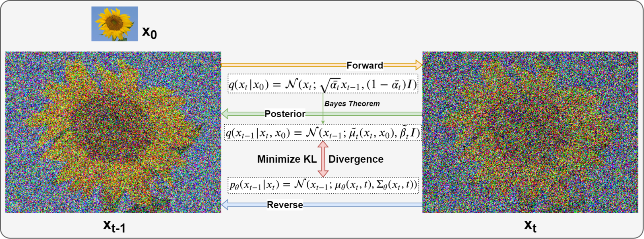
Диффузионные модели
https://learnopencv.com/denoising-diffusion-probabilistic-models/

Slide 33
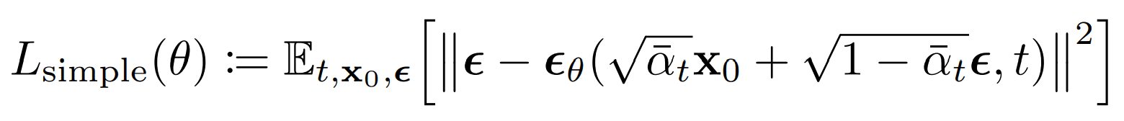
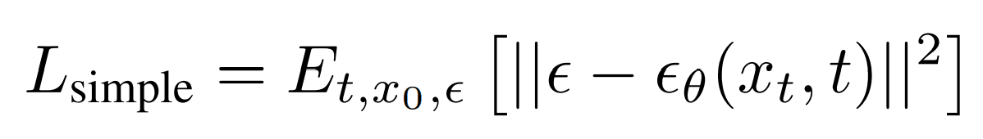
Диффузионные модели

Slide 34
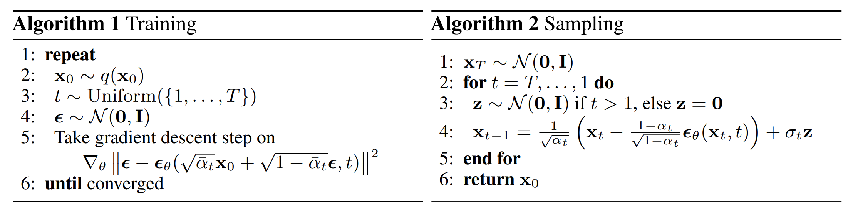
Диффузионные модели

Slide 35
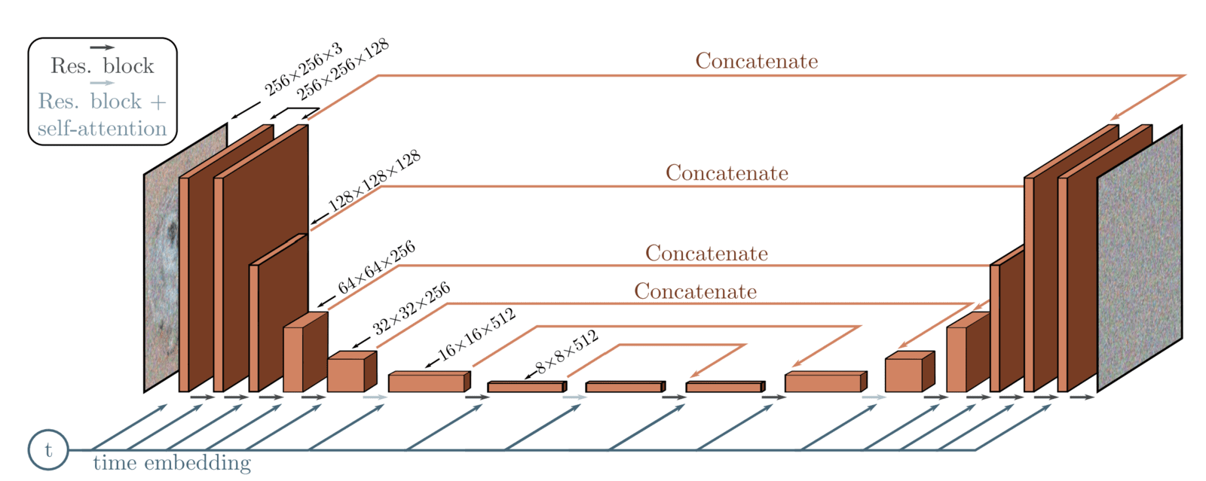
Диффузионные модели

Slide 36
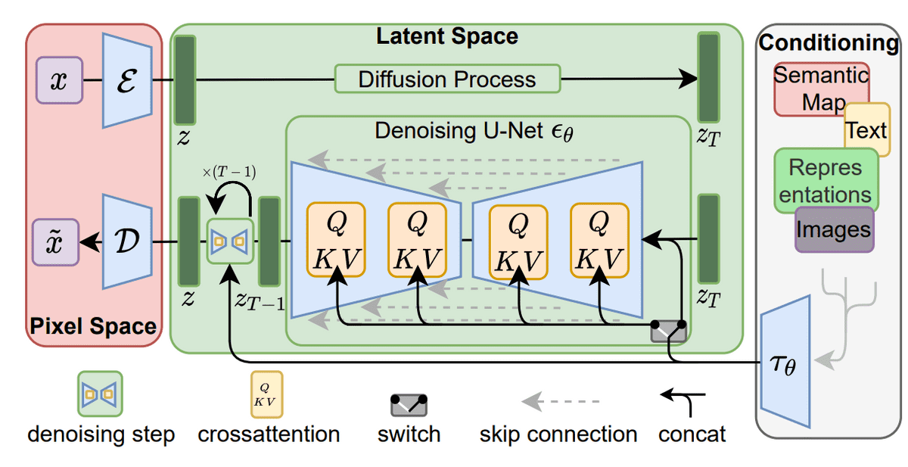
Диффузионные модели

Slide 37
Диффузионные модели
Diffusion Models: Tutorial and Survey
Lecture Notes in Probabilistic Diffusion Models
Denoising Diffusion Probabilistic Models
How diffusion models work: the math from scratch
What are Diffusion Models?
An In-Depth Guide to Denoising Diffusion Probabilistic Models DDPM – Theory to Implementation
Diffusion Course

